Slide 1
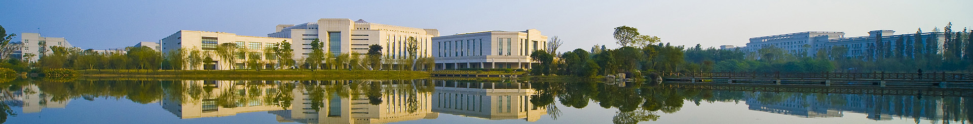
Measurement the apex angle of a prism and the wavelengths of lines in the spectra of mercury by Spectrometer
University Physics Experiment Center

Slide 2
outline
Content
1 Background
2 Aim
3 Principle
4 Equipment
5 Procedure
6 Questions
7 Expand training
8 Experimental data recording and processing

Slide 3
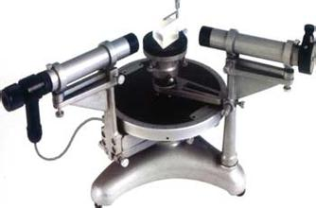
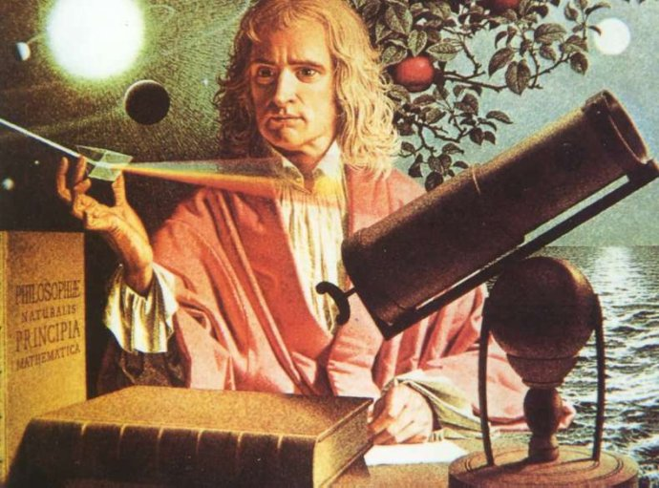
Background
Background
1.1 spectrometer
Spectrometer is an equipment for measuring micro angle 1′
（Isaac Newton，1642~1726）inventor for the spectrometer
(Joseph Fraunhofer, 1787～1826) Belts prism spectrometer carefully studied the solar spectrum.

Slide 4
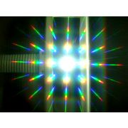
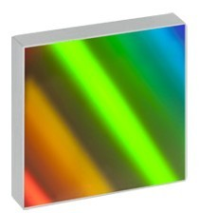
1. background
1.2 Diffraction grating
Former gratin
(David Rittenhouse, 1732～1796)
1786, between the two made by a watchmaker fine screw, parallel to the filament winding to form a diffraction grating.
parameter：4.3line/mm
Divided to
Reflection gratings and transmission gratings
Amplitude grating and the phase grating

Slide 5
2. aim
2. aim
Understanding of the structure and the basic principles of the spectrometer
Learn to adjust and use spectrometer
Observed diffraction grating, to understand the basic laws of diffraction gratings
Learn to use spectroscopy and wavelength grating constant

Slide 6
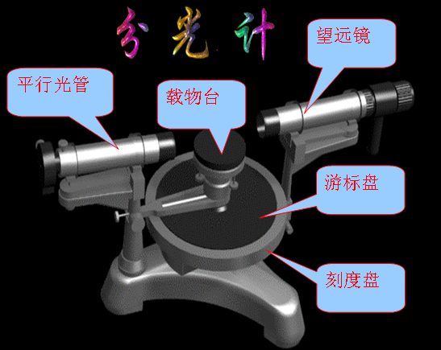
3. principle
3. principle
3.1 structure

Slide 7
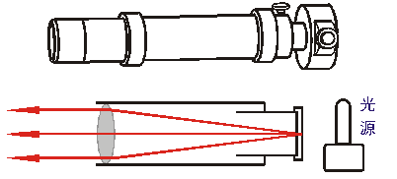
3. principle
3.1 structure
Collimator
Collimator role is to produce a parallel light.
One end of the tube is equipped with a tube move back and forth along the sleeve, the sleeve end with a slit width adjustable;
The other end of the tube is equipped with a converging lens.
Moving back and forth along the tube slot means when the slit is located just on the focal plane of the lens, the light impinging on the slit after the lens becomes parallel light.

Slide 8
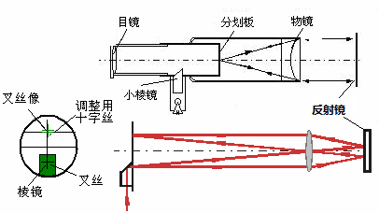
3. principle
3.1 structure
telescope
Auto collimation methods:
1.from the eyepiece, reticle between the objective lens and can be adjusted,
2.when adjusting the reticle is located in the focal plane of the objective lens,
3.the light emitted through the objective lens crosshairs after becoming parallel light.
4.The parallel light after the double-sided mirror reflection, and then by the objective lens focused on the reticle plane, formed like crosshairs (green).

Slide 9
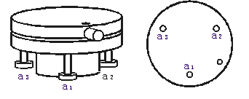
3. principle
3.1 structure
stage
Stage for placing the object to be measured.
There are three screws for adjusting the audience platform level.

Slide 10
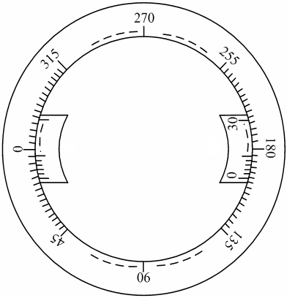
3. 实验原理
3.1 structure
Reading data
Scale disc is divided into 360 °,
minimum scale of 0.5 degrees (30 '),
the use of less than 0.5 degrees cursor readout.
30 grid reading unit 1 'cursor.

Slide 11
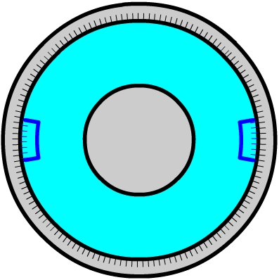
3. principle
3.2 measurement principle
Collimator
Collimator
α₁
α₂
β₁
β₂
telescope
δ
telescope

Slide 12
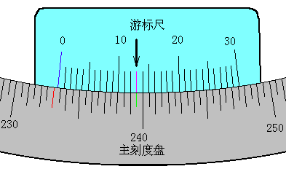
3. principle
3.2 measurement principle
reading
Cursor window
cursor
Main scale
233º
13'

Slide 13
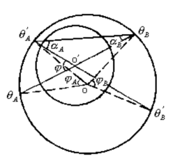
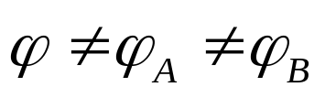
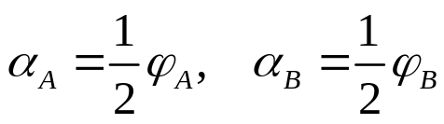
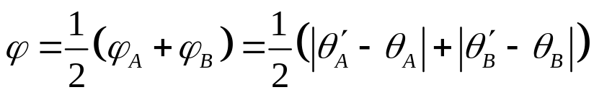

3. principle
3.3 Principle of double cursor m to eliminate eccentricity errors
Two cursors respectively measured angle is φA and φB,
the spectrometer with respect to the center axis O 'is for the angle φ.
Since the axis O with O 'does not necessarily coincide, under normal circumstances
From geometric principles
for
Average of the two cursors measured angle is the actual angle turned.
as

Slide 14
3. principle
3.5 Diffraction grating spectrometer and measuring wavelength of principle
Level 2
screen
Level 1
0
φ
x
f

Slide 15
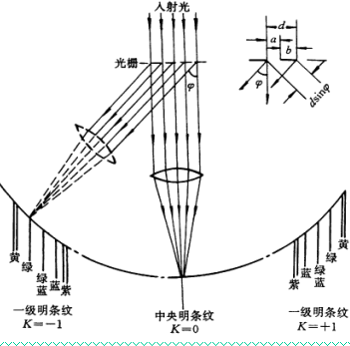
3. principle
3.5 Diffraction grating spectrometer and measuring wavelength
Ming diffraction grating fringes conditions： sinφ=kλ k=0,±1,±2,…
λ wavelength，k bright level
If the grating constant d is known, with all levels of the spectrometer measured spectral diffraction angle φ,
you can find the spectral lines corresponding to the wavelength of light.

Slide 16
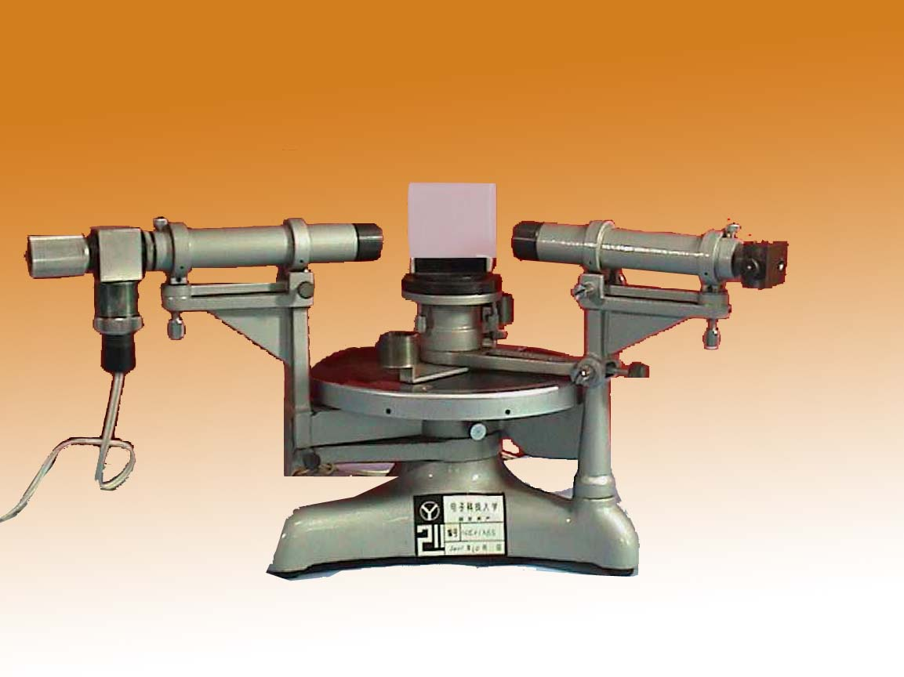
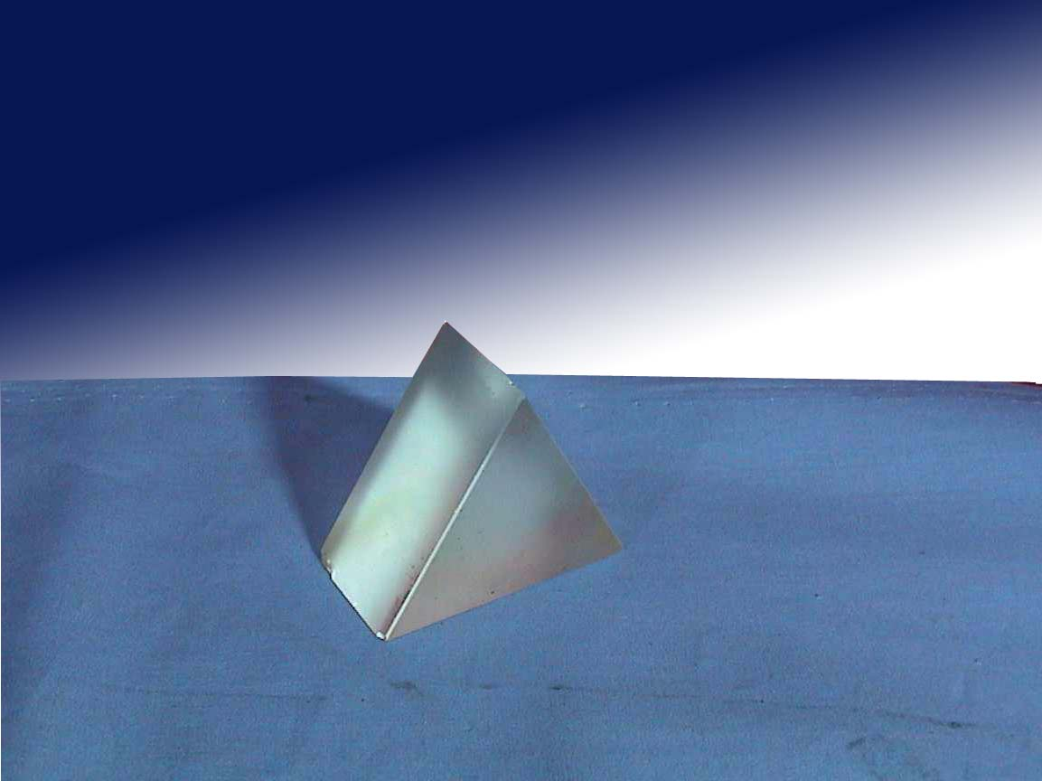
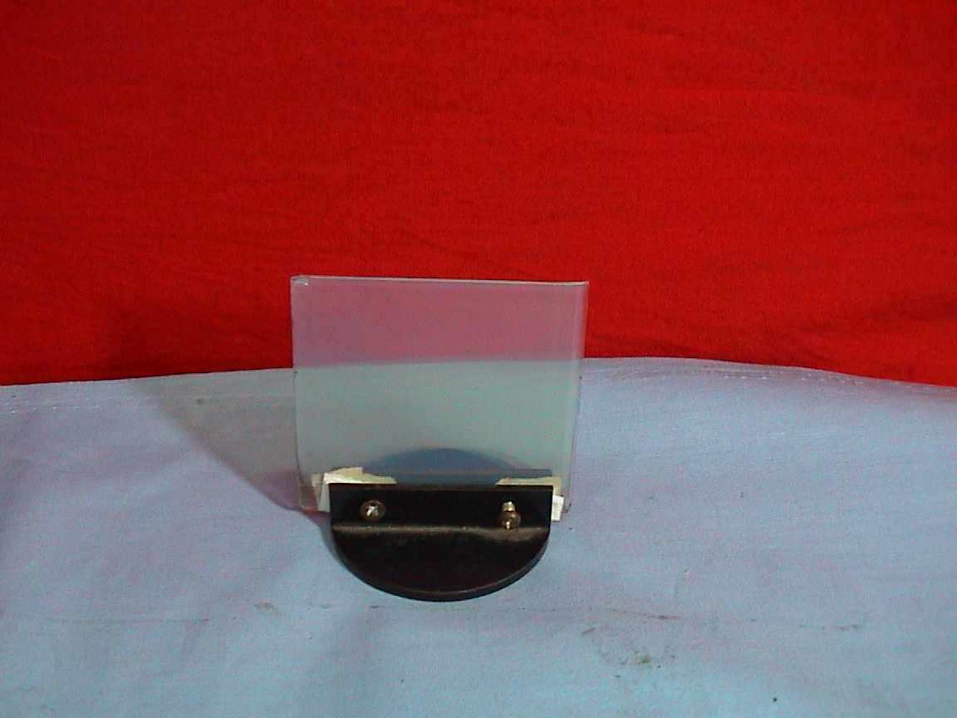
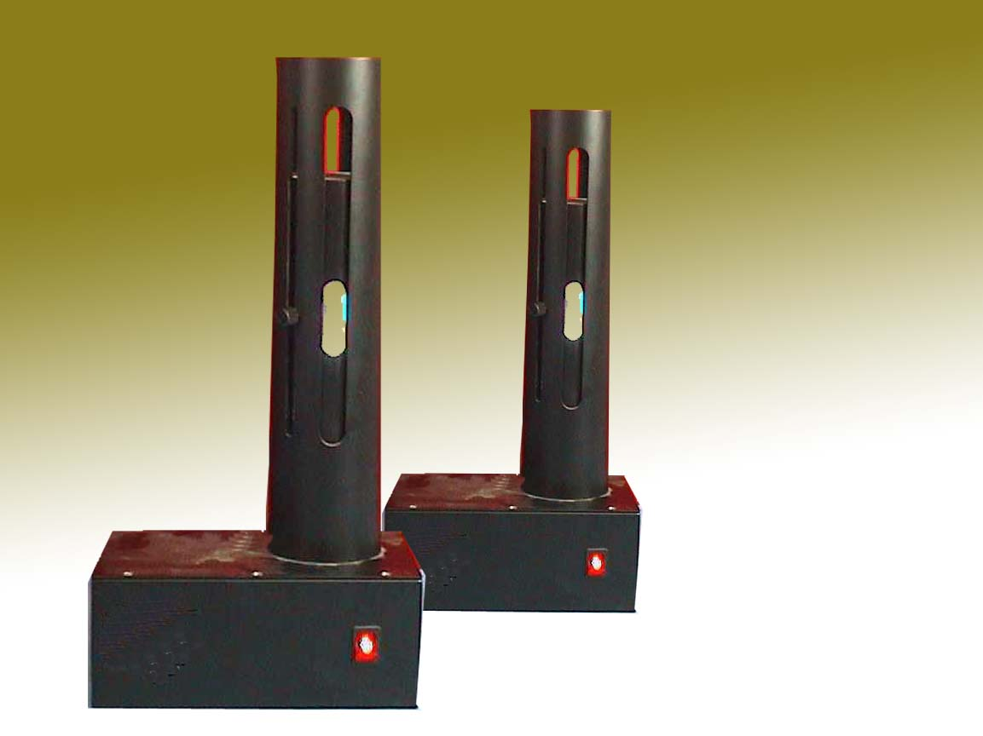
4. 实验器材
4. equipment
spectrometer
Triangular prism
Diffraction grating
Mercury light

Slide 17
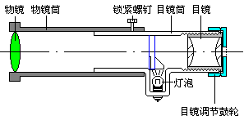
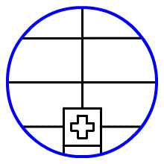
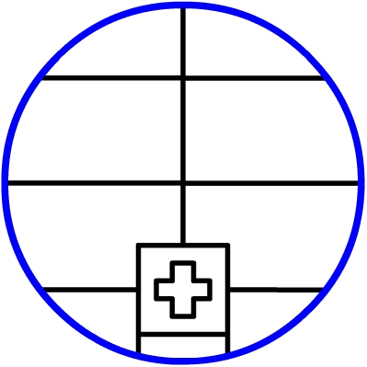
5. process
5.2 adjust
⑶
Reflected image
Cross image
light
Telescopic eyepiece
light

Slide 18
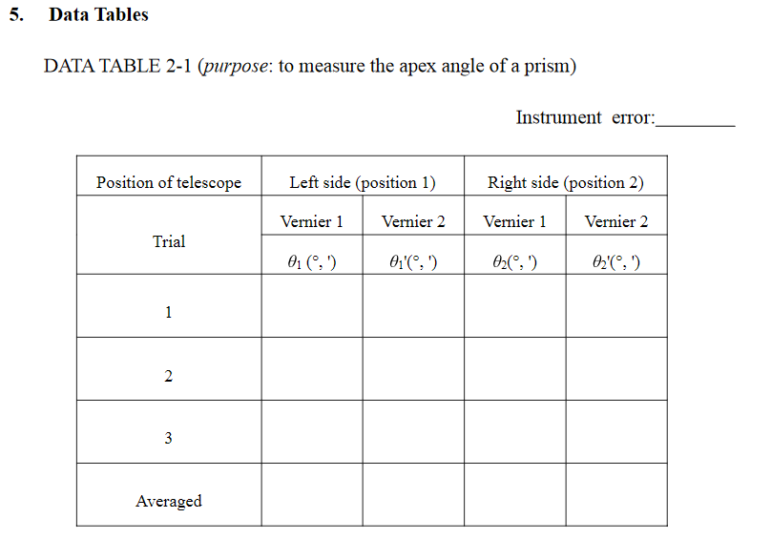

Slide 19
